Slide 1
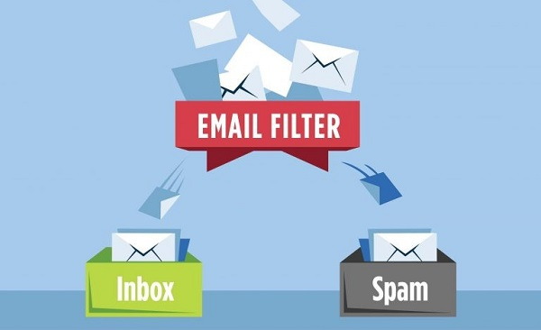

ABUSIVE EMAIL CLASSIFICATION

Slide 2
ABUSIVE EMAIL CLASSIFICATION
~Introduction:-
The project basically classifies text input based on context as abusive or non abusive.
Some users misuse the Emails by sending computer worms and spams which are unrequested information sent to the Email inboxes. Spam Emails cause an overload to the email servers, and consume network bandwidth and storage capacity. Our primary goal is to make a more generalised text classifier that is trained on an email dataset which is hand-labelled as abusive/non-abusive.
~What we understood:-
After going through a lot of research and comparing various websites, we reached at the following conclusions:-
No model can ever be at par with human intelligence for abusive/profanity classification.
The words combinations is innumerable and humans are inventive:-
Some examples are “shit” or “rubbish”
Some people will think the word “grab” as abusive isn’t so?
To train such complex models, we need advanced deep learning technologies which can work effectively against these contexts.
~Facts:- The Truth is that no matter how hard we try to modelize this drawbacks, human will find a way to send spam messages. It would take time and huge computational linguistics to develop an AI that understands this.

Slide 3
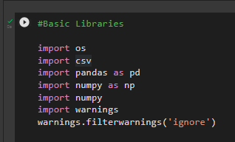
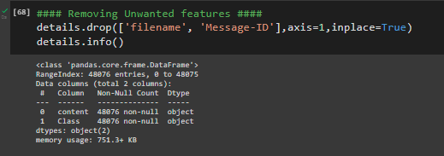
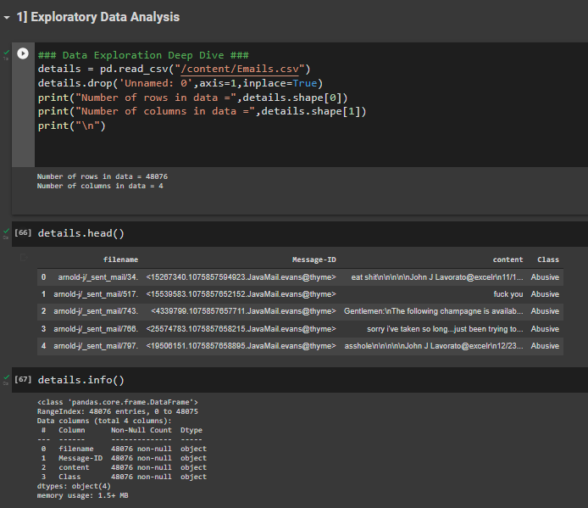
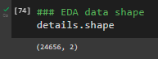
Exploratory Data Analysis
~ Imported all the basic libraries that are required.
~ In data exploration we load the data and dropped the unnamed column from the dataset & check the number of rows & columns in data.
~ we removed unwanted columns from our dataset & then check eda data shape again.

Slide 4
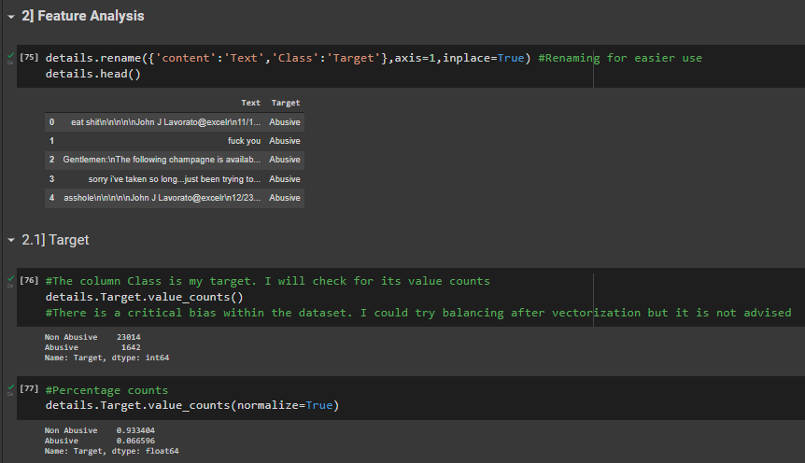
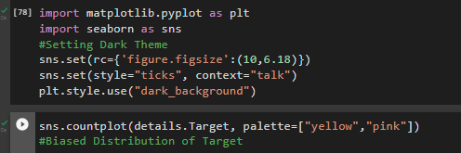
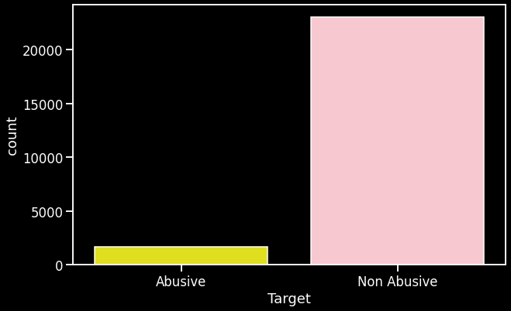
Feature Analysis
VISUALIZATIONS
~we renamed the columns and then took value count of Target column and did percentage count.
~Here is our graph of abusive & non-abusive

Slide 5
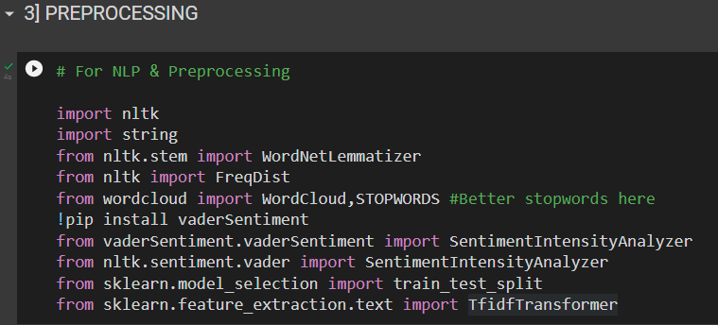
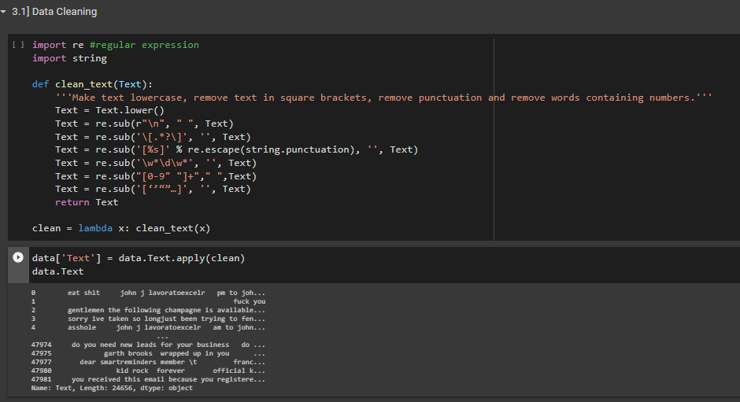
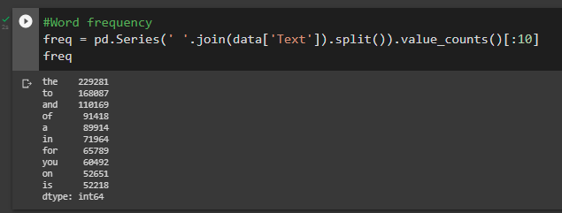
PREPROCESSING
Data Cleaning
~we imported necessary libraries of nlp and preprocessing.
~ Then we cleaned our data using RegEx function, here is our data after cleaning.
Word frequency
~ Word frequency is how often a word appears in a data, divided by how many words there are, Here we calculated frequency of words.

Slide 6
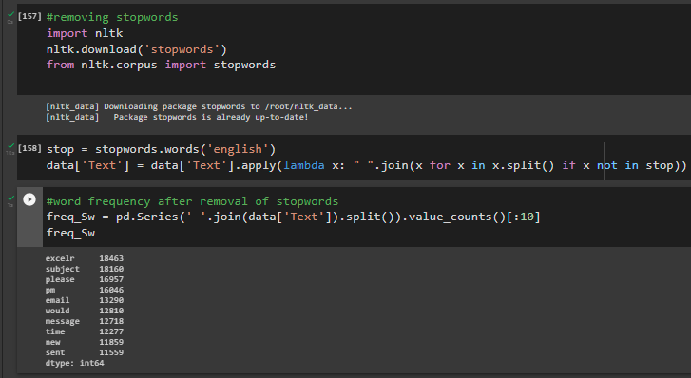
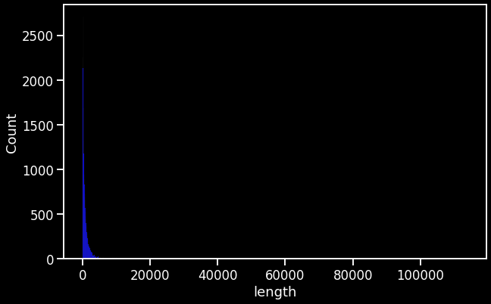
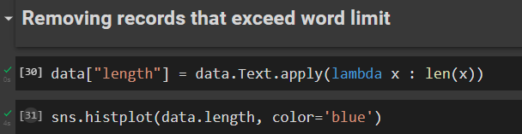
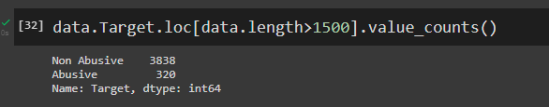
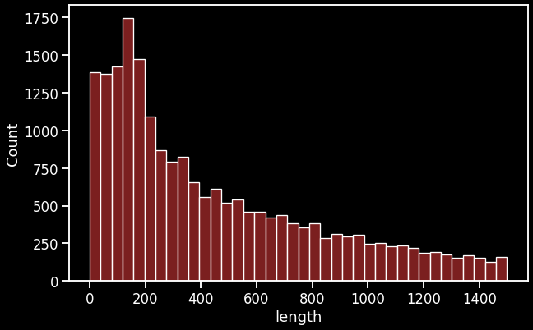
Stop words
Removing records that exceed word limit
~ we removed stopwords from our dataset & after removing stopwords
Here are some list of word frequency
~ We have a large frequency of texts between 0 to 1000 range. Rest of the texts are just outliers and do not add any value to our overall model. Email Texts with excessive words make it difficult due to large number of features.

Slide 7
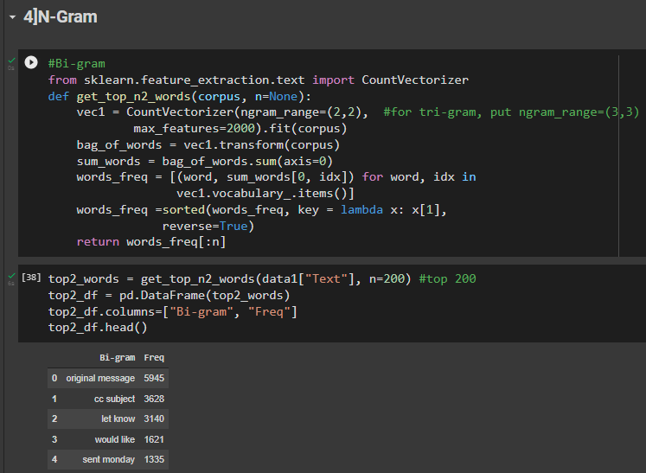
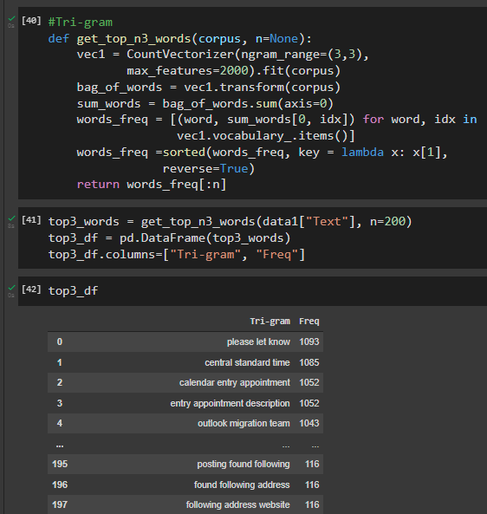
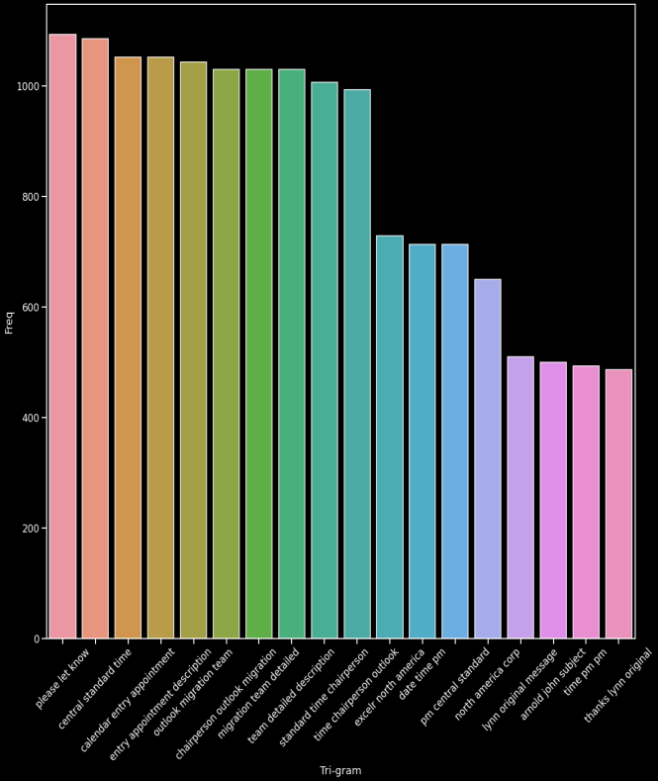
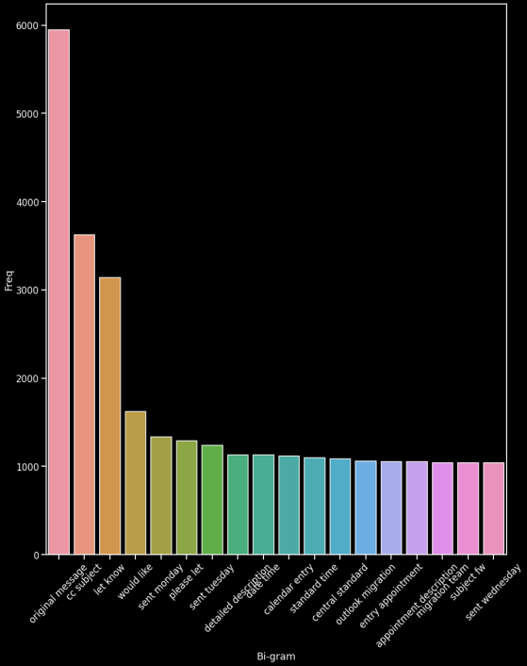
N-Gram
~ An N-gram model is built by counting how often word sequences occur in corpus text and then estimating the probabilities.
Bi-gram
Tri-gram
~ Bigram is a two-word sequence of words.
~ Tri-gram is a three-word sequence of words.

Slide 8
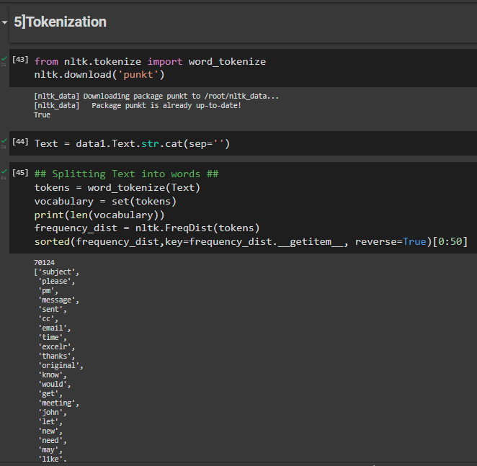
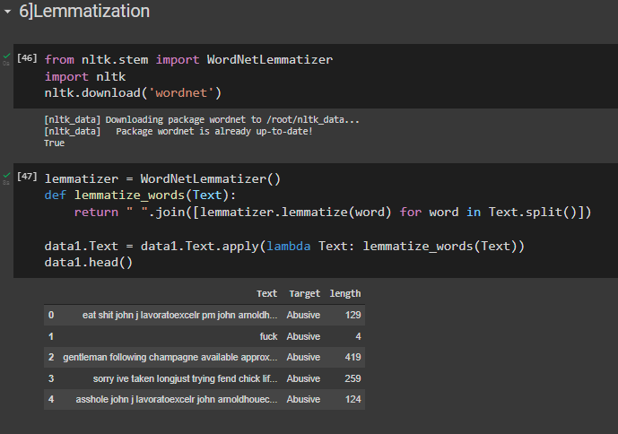
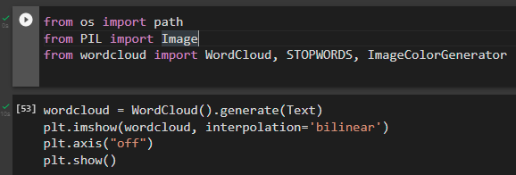
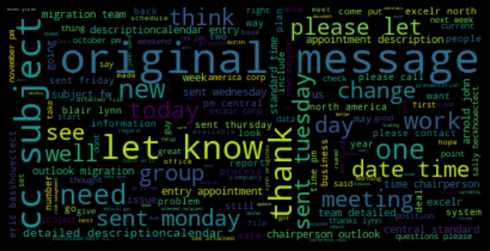
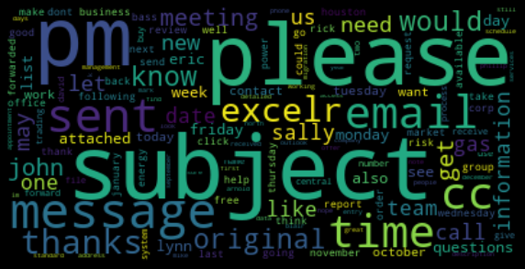
Tokenization
Lemmatization
Word Cloud
~ Tokenization is a way of separating a piece of text into smaller units called tokens.
~ lemmatization returns an actual word of the language, it is used where it is necessary to get valid words.
~ It is a visualization technique for text data wherein each word is picturized with its importance in the context or its frequency.

Slide 9
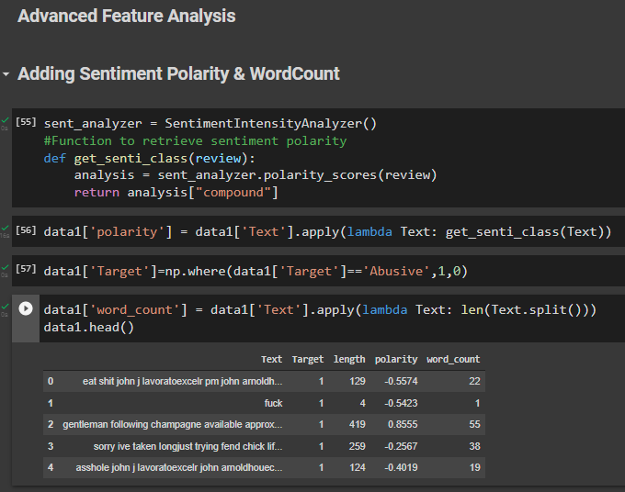
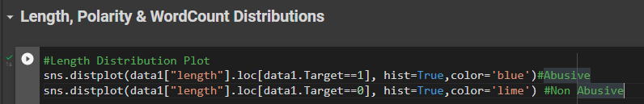
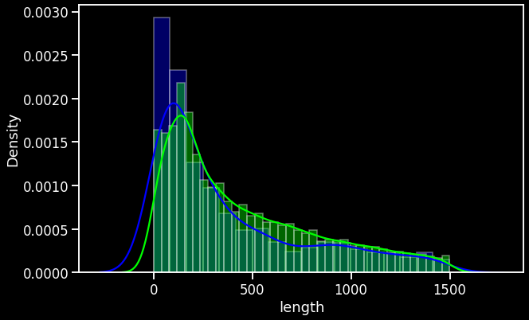
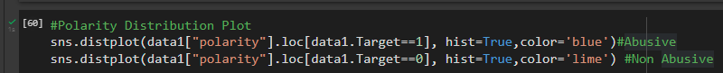
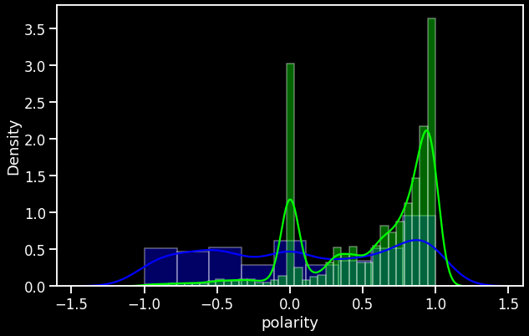
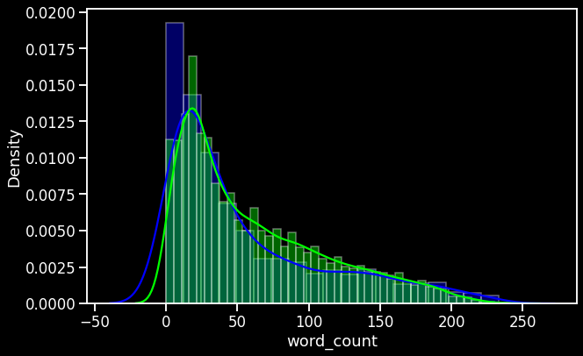
Advanced Feature Analysis
Length, Polarity & WordCount Distributions
Adding Sentiment Polarity & WordCount
~ Sentiment polarity for an element defines the orientation of the expressed sentiment.
~ length distribution plot describes length of the texts as abusive and non abusive.
~ Polarity is float which lies in the range of [-1,1] where 1 means positive statement and -1 means a negative statement.
~ For calculating polarity of a text, polarity score of each word of the text, if present in the dictionary, is added to get an 'overall polarity score'.

Slide 10
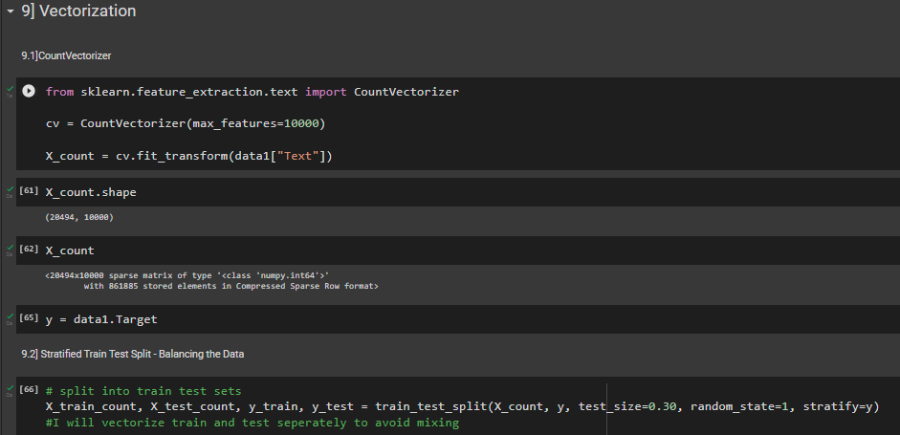
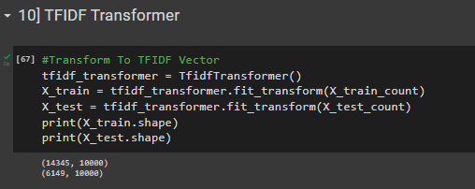
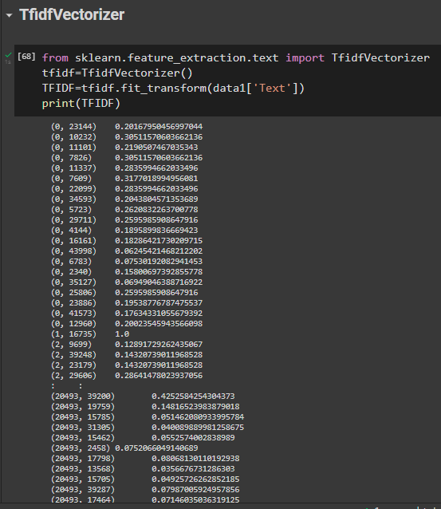
Vectorization
TFIDF Transformer
~ It is used to transform a given text into a vector on the basis of the frequency (count) of each word that occurs in the entire text.
~ TF-IDF is a technique which is used to find meaning of sentences consisting of words and cancels out the incapabilities of Bag of Words technique which is good for text classification or for helping a machine read words in numbers.
Tfidf Vectorizer
~ TfidfVectorizer is the base building block of many NLP pipelines. It is a simple technique to vectorize text documents — i.e. transform sentences into arrays of numbers

Slide 11
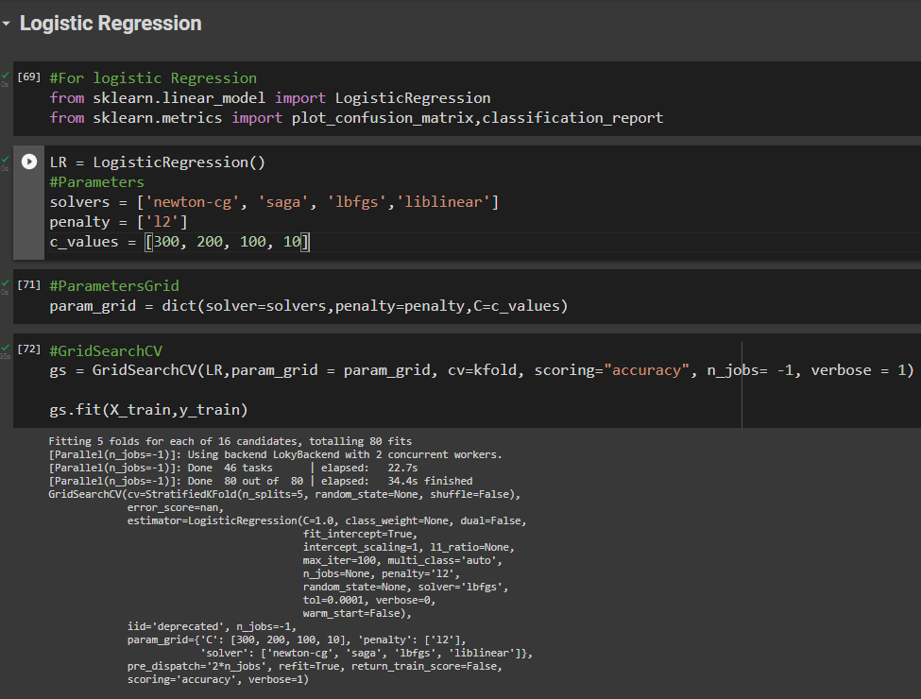
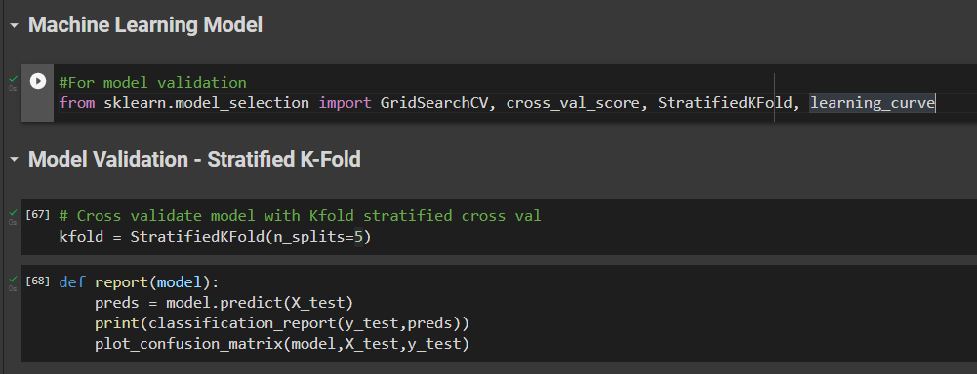
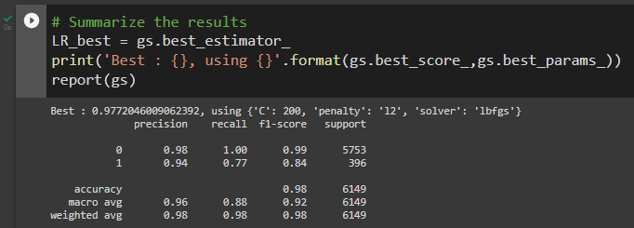
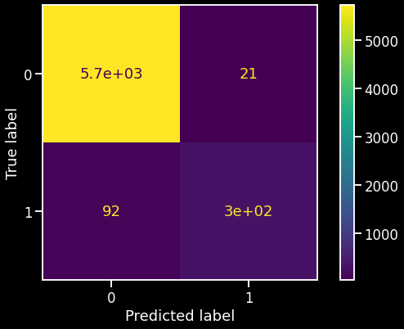
Model Building
Logistic Regression
The model building process involves setting up ways of collecting data, understanding and paying attention to what is important in the data.
Firstly, I did Logistic Regression, in that i imported libraries & took the parameters.
Then, I did grid search cross validation & summarize the results of LR.
Machine Learning Model
A machine learning model is a file that has been trained to recognize certain types of patterns.
Model Validation - Stratified K-Fold
This cross-validation object is a variation of KFold that returns stratified folds.
Accuracy of LR:- 0.97

Slide 12
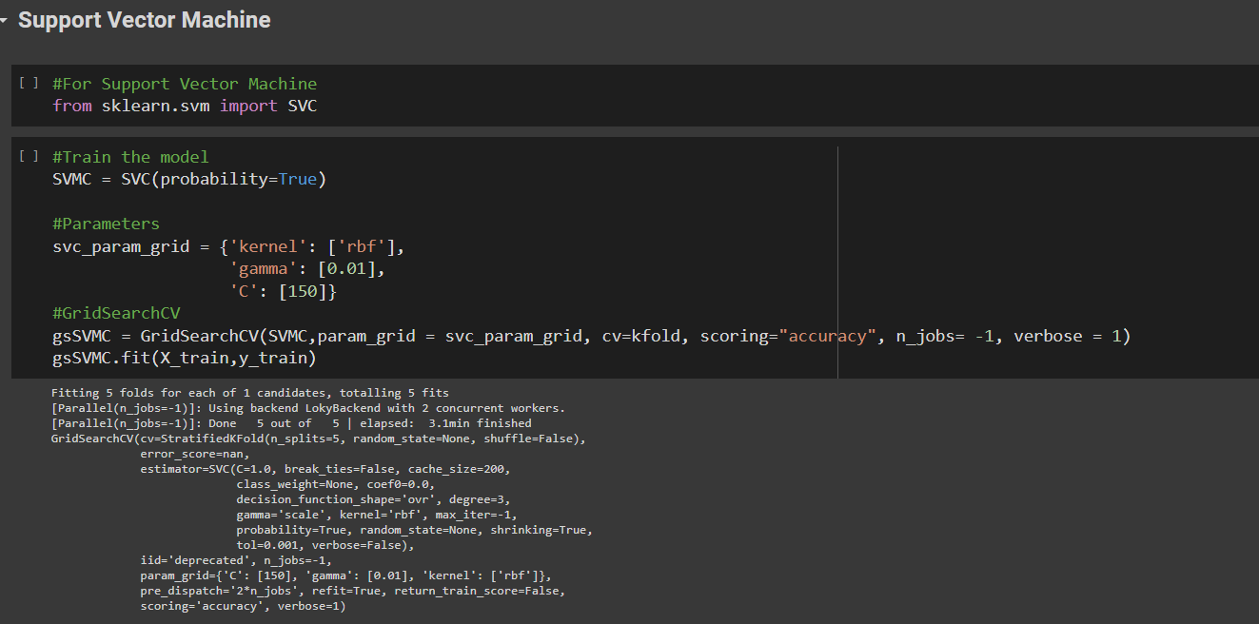
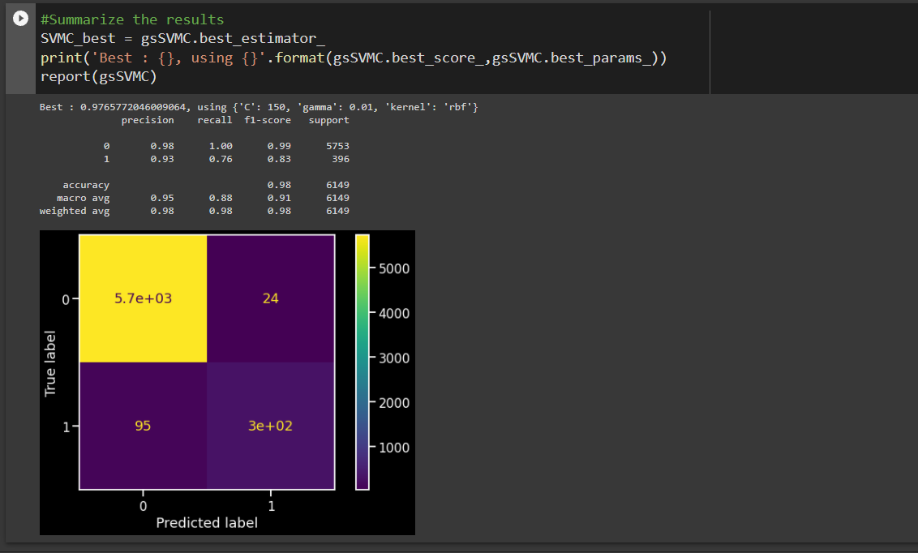
Support Vector Machine
Then, I did SVM & train the model
Took the parameters & grid search cv, and finally summarize the results

Slide 13
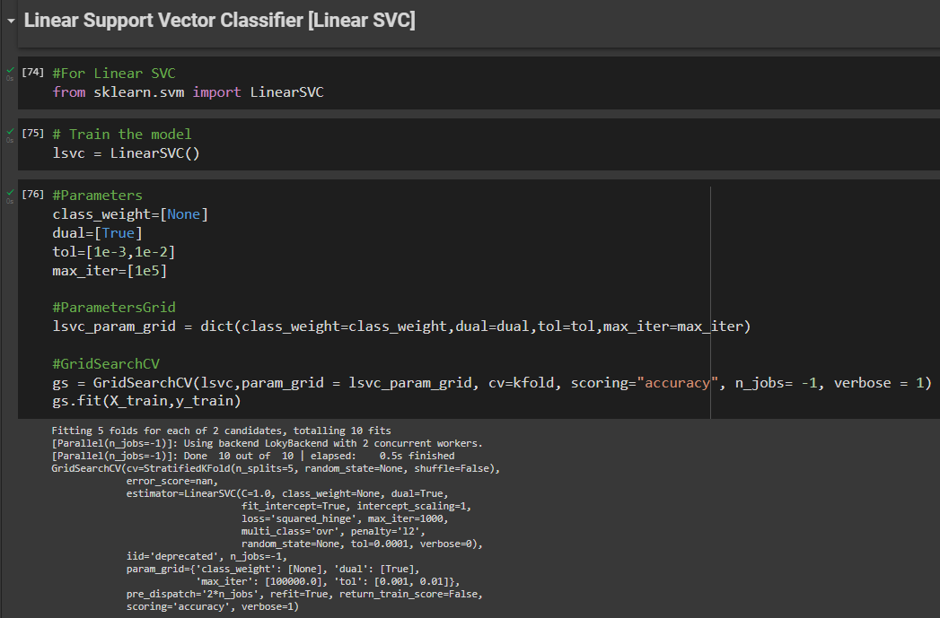
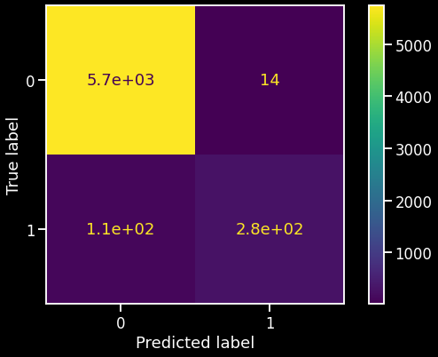
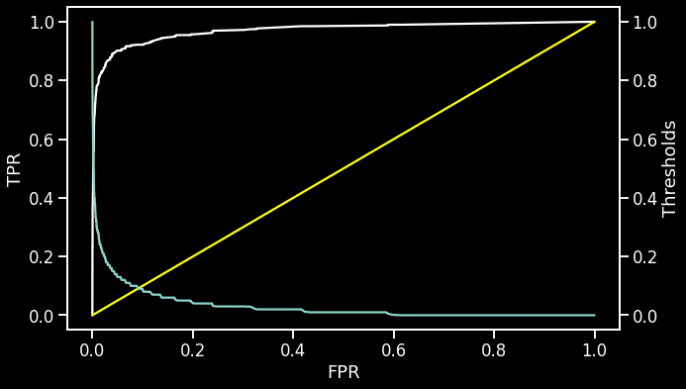
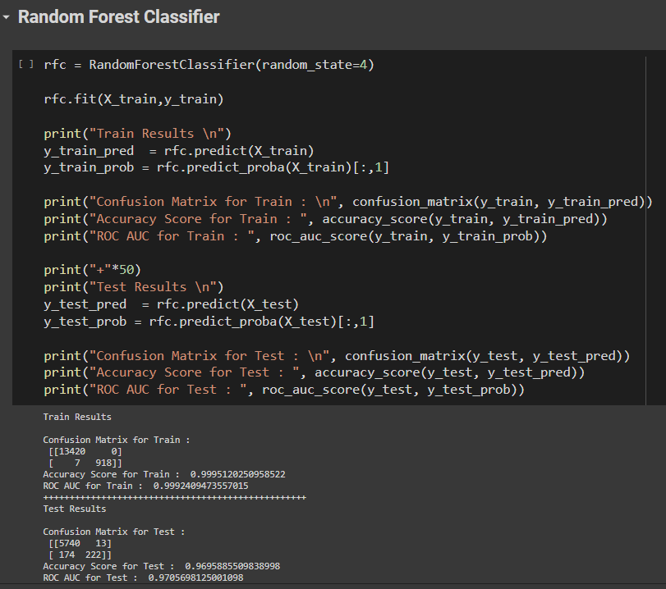
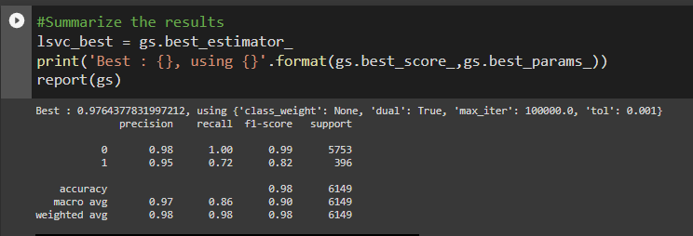
Linear SVC
Random Forest
Random Forest Classifier
Then, I did Linear SVC & train the model.
Then, I switch to rfc & imported the libraries
Took the parameters & grid search cv, and finally summarize the results.
I calculated confusion matrix, accuracy score & ROC AUC for train & test data.
ROC-AUC Curve for Test Data
The ROC curve shows the trade-off between sensitivity (or TPR) and specificity (1 – FPR).
ROC AUC for Train : 0.99
ROC AUC for Test : 0.97
Accuracy of Linear SVC:- 0.97
Accuracy Score for Train : 0.99
Accuracy Score for Test : 0.96

Slide 14
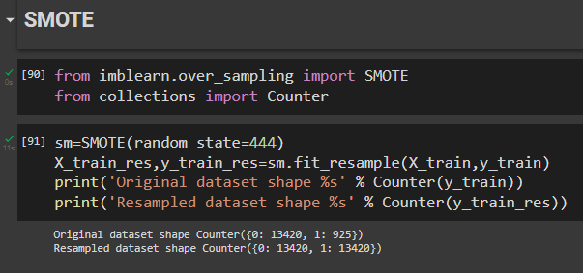
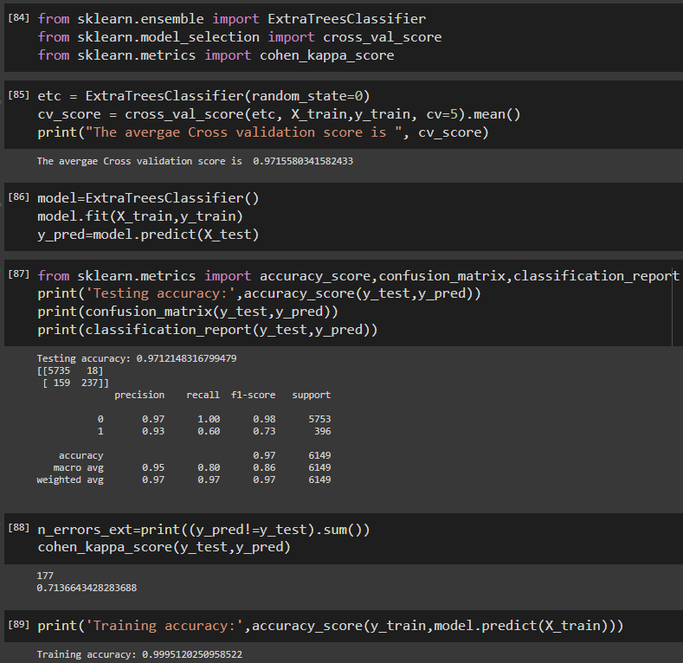
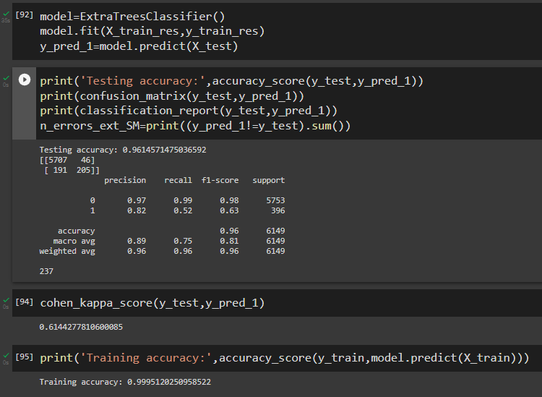
Extra Trees Classifier
SMOTE
In Extra Tree Classifier, I calculated cross validation score & cv score is 0.97.
Then, I fit the model & calculated testing accuracy is 0.97.
Training accuracy:- 0.99.
It is used to obtain a synthetically class-balanced or nearly class-balanced training set, which is then used to train the classifier.
Extra Trees Classifier After SMOTE
After smote, Testing accuracy is 0.96

Slide 15
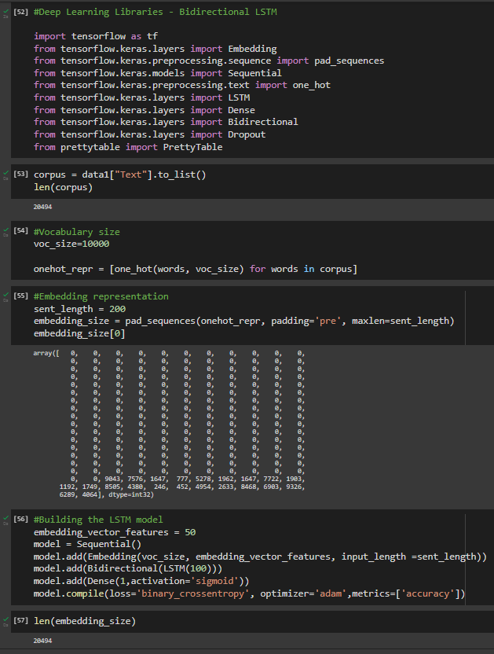
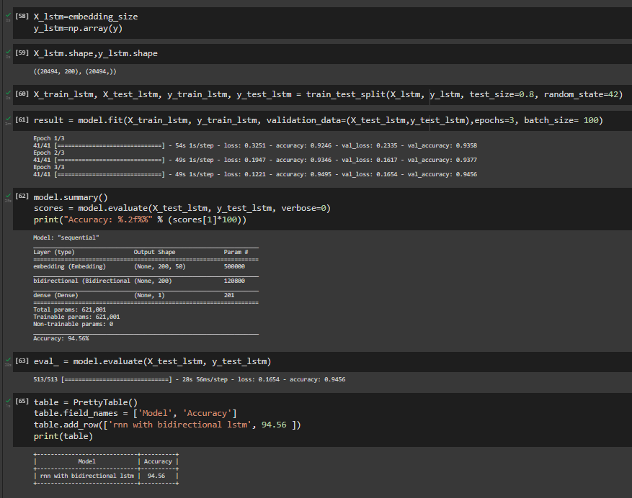
Deep Learning
Deep learning is a subset of machine learning, which is essentially a neural network with three or more layers.
In that I've done two types of deep learning modelling:-
RNN with bidirectional LSTM
CNN using LSTM
RNN with bidirectional LSTM
Firstly, I build the LSTM model for bidirectional, in that I fit the model into training & testing data for validation.
Then, I calculated Accuracy score of rnn with bidirectional LSTM is
94.56.

Slide 16



CNN using LSTM
In CNN using LSTM, I fit the model & accuracy of CNN is 94.83.

Slide 17

Deployment
Atlast, after going through all the models I finalize SVM as my final selection for model deployment.

